Slide 1
Watch Your Ass!
Masculinity, sexuality and games
Derek A. Burrill, UC Riverside

Slide 3
modus
This presentation is meant as a provocation
Image, text, concept, extension
Some traditional explication, but I will also
show images/text and leave time for
contemplation – read/against them

Slide 4
So what’s with the title?
Watch Your Ass!
-- masculinity
-- violence
-- play and games
-- the ‘buddy film’
-- cinematic appeal of games/gaming
-- third person homoerotics

Slide 5
Theories of masculinity
Nature vs. Nurture
Genetics research: SRY gene, Y chromo.
-- masculinity stems from male biology
Sociology and acculturation: aspects that are considered
‘natural’ are linguistically (culturally) driven
Masculinity doesn’t have a central ‘cause’ or ‘source’:
-- media, institutions, family, ethnicity

Slide 6
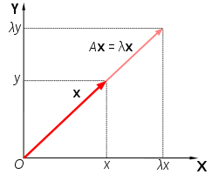

Slide 7
Hegemonic masculinity:
The concept that there are a set of rules
that men must adopt, and that
women must eschew or face penalty (or violence)
“Hegemonic masculinity can be defined as the
configuration of gender practice which embodies the
currently accepted answer to the problem of the
legitimacy of patriarchy, which guarantees the
dominant position of men and the subordination of
women.” -- R. Connell

Slide 8
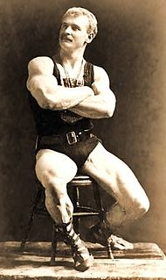
The rules of masculinity
1) constantly ‘prove’ yourself
2) be strong and silent
3) never let them see you sweat
4) separate yourself from the pack
5) disavow any real relationship to other men

Slide 10
Make a game where nobody
has insides. Then, make the outsides
a constantly morphing reflection of
other bodies in the gameworld.

Slide 11
The triad of men’s violence:
Men’s violence against men
Men’s violence against women
Men’s violence against themselves
These overlap, change, dissipate and increase depending on various forces at work in culture
-- Men’s Lives, Kaufman/Kimmel

Slide 12
How is masculinity ‘thought’?
-- essentialist: men are men because of sex/gender --
the ‘one feature’ theory
-- positivist: men are men because they are men --
“what men actually are”
-- normative: men should act like men --
“masculinity is what men ought to be”
-- semiotic: men are defined by what they are not --
“men are men because they are not women”
R. Connell

Slide 13
Masculinity as technology
Technology is an imaginary and
real space where masculinity
and men are both
imploded and exploded
Heidegger’s notions of poiesis and techné
The external world as a ‘standing reserve’

Slide 14
Play a game against yourself
where you are the protagonist and the
antagonist.
See who wins.

Slide 15
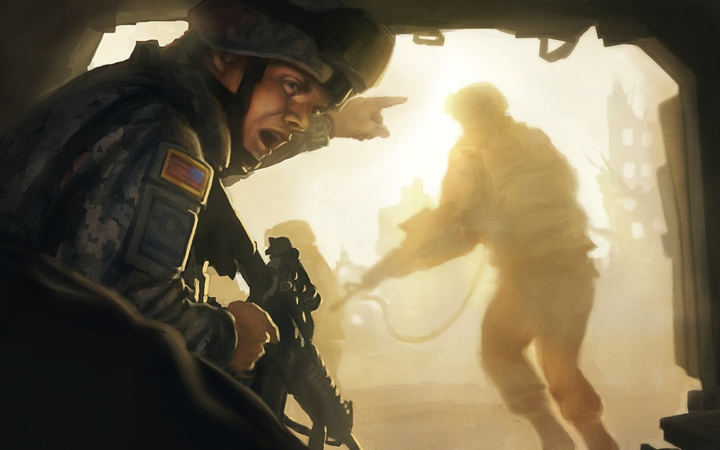

Slide 16
My approaches to gender in relationship to games research
Gender is largely socially constructed
Gender is performative/dramaturgical
So in many senses, we express gender as
a series of masks/costumes
“boyhood” – a regressive masculinity
conditioned by gameplay, free from
mature responsibility
Also, we tend to perform our gender roles by mimicking
other available, privileged texts/bodies
-- The process of ‘iteration and maintenance’

Slide 18
Current research on gender and
gaming:
Young boys and girls play games very differently
Boys favor rules that are inflexible – this provides fairness
Girls favor rules that are flexible – this provides fairness
Girls favor cooperative work
Boys are equally happy to play alone
Girls steer away from violent content,
boys steer toward it

Slide 19
Homosexuality is a word invented in
the 19th century in order to clinically
describe the “perversion” that was
same sex intercourse.
Always consider that the word has a
negative connotation, as it was a clinical
term that described a person’s sexual
activity, not their identity.
‘Lesbian’ and ‘gay’ are more welcome.

Slide 20
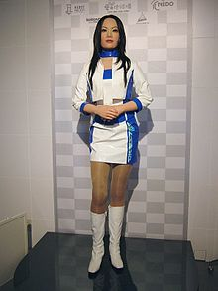

Slide 21
Build a game so that if the player
doesn’t pass as the opposite gender,
they get gay bashed.

Slide 22
The word ‘queer’ has been reclaimed
as a positive term to describe a
wide range of behaviors, attitudes
and identities. It’s positivity lies in
an umbrella effect that questions
notions of heteronormativity and
straightness/narrowness.

Slide 23
3 radical models of gender
Judith Butler (UC Berkeley)
Katherine Hayles (Duke University)
Donna Haraway (UC Santa Cruz)

Slide 24
Judith Butler
Queer/feminist/political theorist
“compulsory heterosexual normativity”
Gender assignment is a means of sustaining the
ruling political binaries
Emphasis on the vulnerable, unintelligible,
unknowable, unrepresentable
Resistance to normativity takes on the form of ‘body
drift’: queering bodies, ideology, politics, gender

Slide 25
Katherine Hayles
The ‘human’ as we know it has been transformed
by the “regime of computation”
The body is being remade at the border of materiality
and simulation
The arrival of the post-human subject
inevitably leads to:
-- postgender
-- postsexuality
-- postidentity
-- postconsciousness

Slide 26
Hayles, continued:
“Rejecting the perspective of technological
determinism as much as the celebration of
technology as a (religious) singularity, Hayles’
cultural achievement lies in suggesting a
critical perspective on technology, in which
the human species limits itself to that of a
“co-evolving” partner in the relationship, and,
against the technical will to disembodiment
and immateriality, that human subjectivity
recover the possibility of embodied consciousness.”
-- A. Kroker

Slide 28
Donna Haraway
Early work included “The Cyborg Manifesto”
-- ways to rethink gender through the mixing
of machine and body
Butler – contingency / Hayles – complexity
Haraway – hybridity
The intersection of humans, plants, animals and
minerals coupled with the complexities of
female bodies
Humans as ‘companion species’; the intersection,
the knot, the intermediation

Slide 29
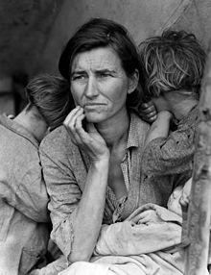

Slide 30
“The perfection of the full defended, “victorious”
self is a chilling fantasy, linking phagocytotic
amoeba and moon-voyaging man cannibalizing
the earth in an evolutionary teleology of
post-apocalypse extra-terrestrialism. It is a
chilling fantasy, whether located
in the abstract space of national
discourse, or in the equally
abstract spaces of our interior
bodies.”
- D. Haraway; Simians, Cyborgs and Women:
The Reinvention of Nature

Slide 31
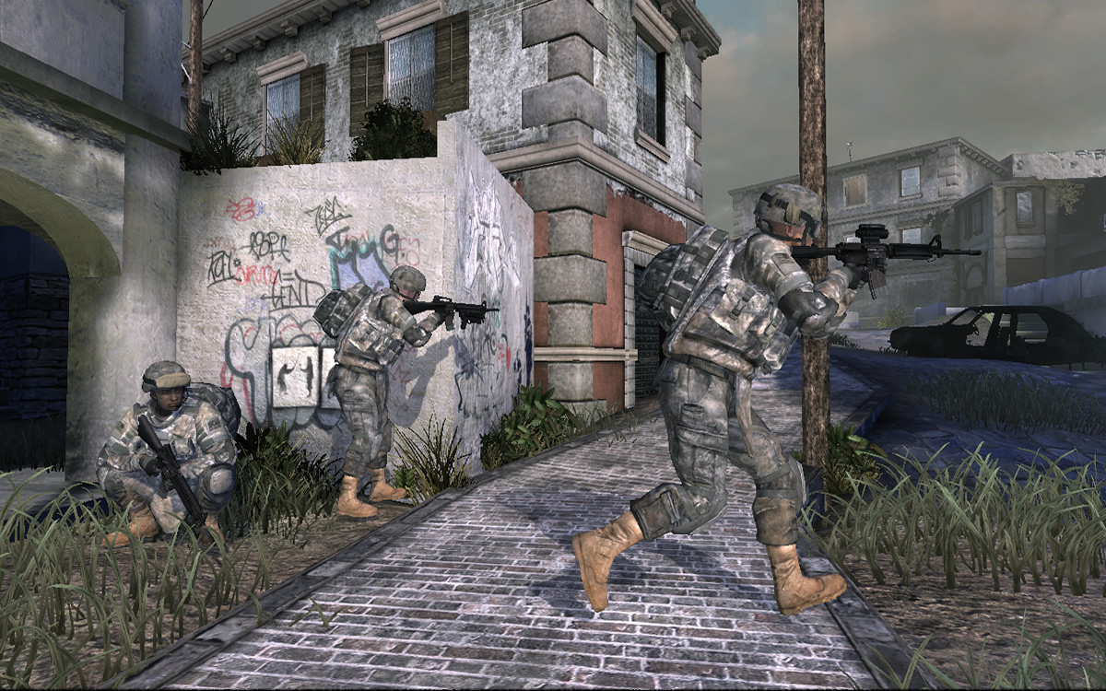
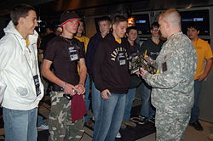
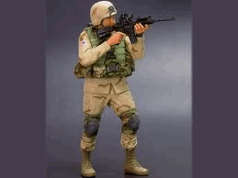
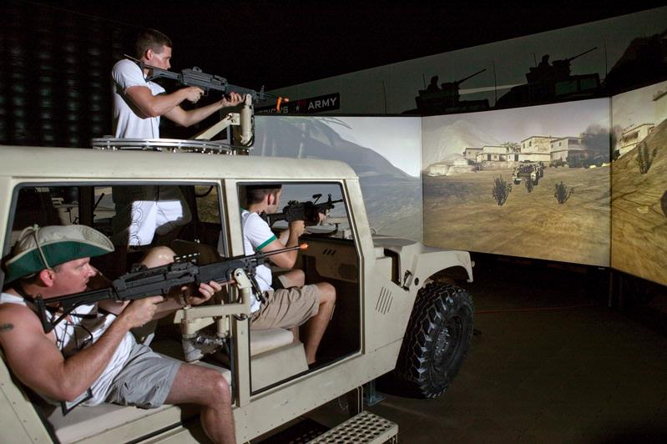

Slide 32
The U.S. Department of Defense estimates
that 26,000 sexual assaults occured in the
military in 2012
These are overwhelmingly perpetrated by men
against women
In 2012, only 1,108 have filed for an investigation
575 of those cases were processed
96 went to court-martial

Slide 33
The more deluded and insecure
a person is, the more likely they
are to see patterns where none
exist.

Slide 34
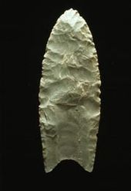

Slide 35
“In “The Cyborg Manifesto,” I tried to write a surrogacy
agreement, a trope, a figure for living within and honoring
the skills and practices of contemporary technoculture
without losing touch with the permanent war apparatus of
the non-optional, post-nuclear world and its transcedent,
very materialist lies. Cyborgs can be figures for living
within contradictions, attentive to the naturecultures of
mundane practices, attentive to the dire myths of self-birthing,
embracing mortality as the condition for life, and alert to the
emergent historical hybridities actually populating the world at
all its contingent scales.
However, cyborg figurations hardly exhaust the tropic work
required for ontological choreography in technoscience. I have
come to see cyborgs as junior siblings in the much bigger, queer
family of companion species, in which reproductive biotechno-
politics are generally a surprise, sometimes a nice surprise.”
The Companion Species Manifesto, D. Haraway

Slide 37
“In the same way that performance (and the
performance of gender) signifies as a complex field
of interconnected signs and symbols, so too does
interactive software, within its own representational
field and within the media matrix that includes it
in the machines of capital. This is perhaps why it
is so important to carefully critique and study this
medium. Like other digital technologies, interactive
software forms a particularly seamless unification
with other modes of production in support of
dominant ideologies and the forces that seek to
cover up and/or exploit the marginalized and
underrepresented.”
D. Burrill, Die Tryin’

Slide 38
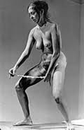

Slide 39
State sanctioned violence is the
product of a culture where
domestic violence is normalized
against a backdrop of representational
violence. In overwhelming numbers,
women are the victims of domestic
violence, and therefore, ideological
violence. But, games are just for fun.
Boys will be boys.

Slide 40
Central assertion:
Game structure and haptic architecture emphasizes and
interpolates certain behaviors in the player -- these mimic
subject formation within the cycles of media signification,
commodity capitalism and postmodern culture
-- games are an ideological machine that manufactures an ideal
subject position – the transcendent male
-- this reflects heteronormativity
-- this is an implied rejection other forms of masculinity and
sexuality
-- this situation is inherently performative and self-reflexive
-- the positionality is inherently dominating and subjugating

Slide 41
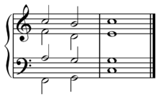
Open source metaphor
Tonality vs. atonality
In functional tonality, each triad has a tonal
function in relation to the tonic triad, and with
other triads in the key
Femaleness, queerness,
maleness
Dissonance and consonance

Slide 42
“This is how it should be done. Lodge yourself on a
stratum, experiment with the opportunities it offers,
find an advantageous place on it, find potential
movements of deterritorialization, possible lines of
flight, experience them, produce flow conjunctions
here and there, try out continua of intensities segment
by segment, have a small plot of new land at all times.
It is through a meticulous relation with the strata
That one succeeds in freeing lines of flight, causing
conjugated flows to pass and escape and bringing
forth continuous intensities for a BODY
WITHOUT
ORGANS.” Deleuze and Guattari

Slide 43
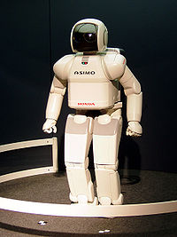

Slide 44
Assignment
Read: Games of Empire:
Global Capitalism and Video
Games, Nick Dyer-Witheford
and Greg de Peuter

Slide 46
aEsTHetICS

Slide 47
As bodies in the world, and bodies
who work with technology:
We have a shared responsibility to create
shared, intermediated, equitable worlds
that don’t just replicate or uphold the
laws of heteronormativity or patriarchy,
but reflect, represent and promote
contingency and complexity so that virtual
worlds are compelling and productive for
all.

Slide 49
5 challenges
1) Expand the definition of narrative
2) Create characters that don’t just confound
stereotypes, but obliterate them
3) Stop making violence concomitant with
progress in the game
4) Don’t just speak for yourself, or for your
employer, speak for the global community
5) Actively seek gender parity in all labor and
creation

Slide 50
In order to break out of the
prison house of sexism, misogyny
and masculine dominance, we
have to rethink how to move in
and share Space,
to build worlds for different
kinds of movement(s),
to make room for every kind
of body and position.

Slide 51
It is entirely reasonable to be a bit
reticent to engage in the discussion.
Just be compassionate and open, the
way we all are about games and
gaming. Gender and sexual equality,
like games, are made by people who
struggle toward a common goal.
If you build games, you are responsible
for ‘cultural vision’ -- what a fantastic
gift!

Slide 52
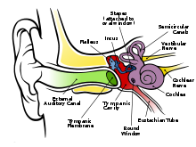
polyvocality
This slide is silent. It marks the voices stolen
from women and those allied with the queer
project(s).
This disrupts the logocentrism and ‘authority’
of my voice.
Please insert your own voice here.

Slide 53
Thanks to:
Everyone at GGC and
Gotland U.
Ulf , Adam, Sara, Tom, Heidi and Will
for due diligence and passionate
advocacy
Ford Foundation and UCHRI

Slide 54
Watch Your Ass!
Masculinity, sexuality and games
Derek A. Burrill, UC Riverside, derekb@ucr.edu

